Slide 1
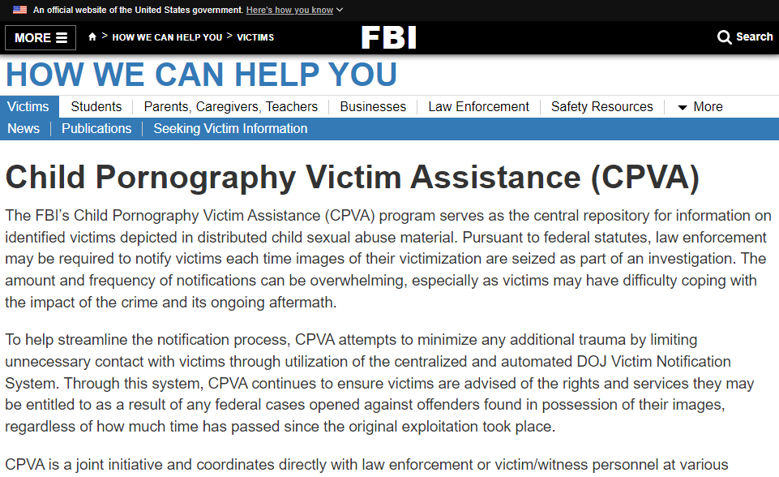


Slide 2
FBI
Principal, King History 1994
CAR(Carl-Benz)
1900 Max-Plank Former Federal Republic of (US) Germany
1909 Albert Einstein uses Max-Plank (Physics Algorithms to explain Quantum)
1945 Albert Einstein Manhattan Project
2000 Max-Plank Institute Checkpoint Charlie
2019 Police Manhattan
2023 Police Fort Worth
Government Texas
United States Government
Federal Court and Federal Republic(US) Germany Court (Dr. Behr) Michigan, LLM
WMD
Max-Plank Heat Radiation CHILD ABUSE Toaster
Physics ibm.damiler.Thomas Physics Teacher
C++ nonPoliceRussian.nonPoliceAtomics
KIT ibm.demail.pope.francesco
ibm.daimler.WAR
ibm.daimler.Whitehouse
B-10

Slide 3
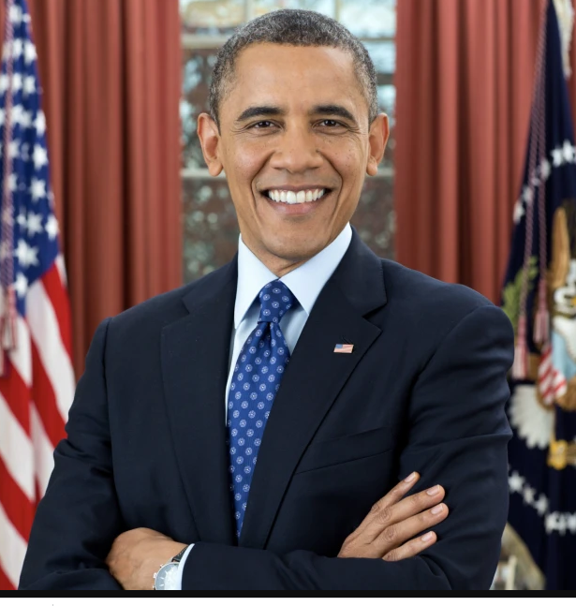
FBI
Federal Court and Federal Republic(US) Germany
Court (Dr. Behr) Michigan, LLM
CLOCK
WMD
WHITE
Principal, King History, WWI
1900 Max-Plank Former Federal Republic of (US)
Germany
1909 Albert Einstein uses Max-Plank (Physics Algorithms to
explain Quantum)
Dr. Dr. Prof. Joachim F.
Dr. Prof. Juergen Zimmerman
Dr. Maik Linder, ibm.daimeler.sap
DUB-LG (Dublin-Los Gatos/Campel)
Dr. Jan Auernhamem, ibm.dmiler.google
DUB-Moutain View
Dr.
Max-Plank Heat Radiation CHILD ABUSE Toaster
Physics ibm.damiler.Thomas Physics Teacher
C++ nonPoliceRussian.nonPoliceAtomics
ibm.daimler.WAR
ibm.daimler.Whitehouse
BLACK
Ron Ronson
Dr. Dre, (Tim cook)
B-10

Slide 4
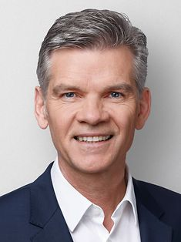
FBI
CLOCK(quartz)
CAR(K-TOWN)
WMD
FEDERAL REPUBLIC GERMANY
WWI King History,
Principal
WWII King History
HOMICIDE IPX Bill
1900 Max-Plank Former Federal Republic of (US)
Germany
1909 Albert Einstein uses Max-Plank (Physics Algorithms to
explain Quantum
Dr. Dr. Prof. Joachim F.
Dr. Prof. Juergen Zimmerman
Dr. Maik Linder, ibm.daimeler.sap
DUB-LG (Dublin-Los Gatos/Campel)
Dr. Jan Auernhamem, ibm.dmiler.google
DUB-Moutain View
Dr.
Max-Plank
Goethe
Max-Plank Heat Radiation CHILD ABUSE Toaster
Physics ibm.damiler.Thomas Physics Teacher
C++ nonPoliceRussian.nonPoliceAtomics
1970 bis 1979
Goethe-Gymnasium
Karlsruhe.
ibm.daimler.WAR
ibm.daimler.Whitehouse
B-10

Slide 5
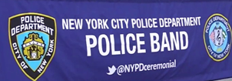
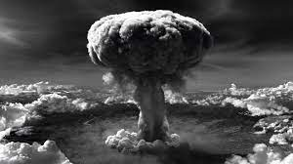
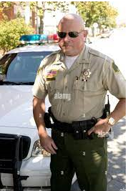
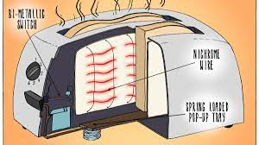
FBI
2000
WAR
CHILD ABUSE
nonPoliceQuantum
1909 Albert Einstein uses Max-Plank (Physics Algorithms to explain Quantum)
2000 Max-Plank Checkpoint Charlie
Heat Radiation
C++
Like
Like
Phyics Tutor
ibm.daimler.WAR
ibm.daimler.Whitehouse
B-10

Slide 6
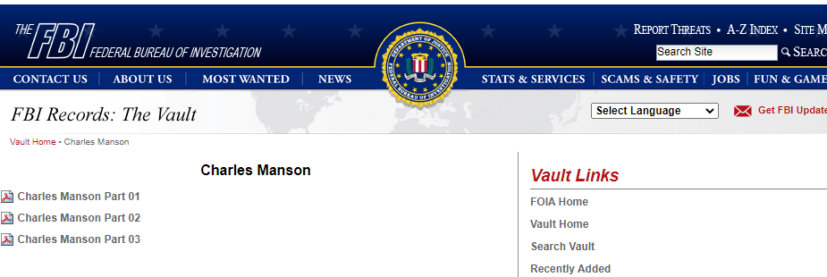

Slide 8
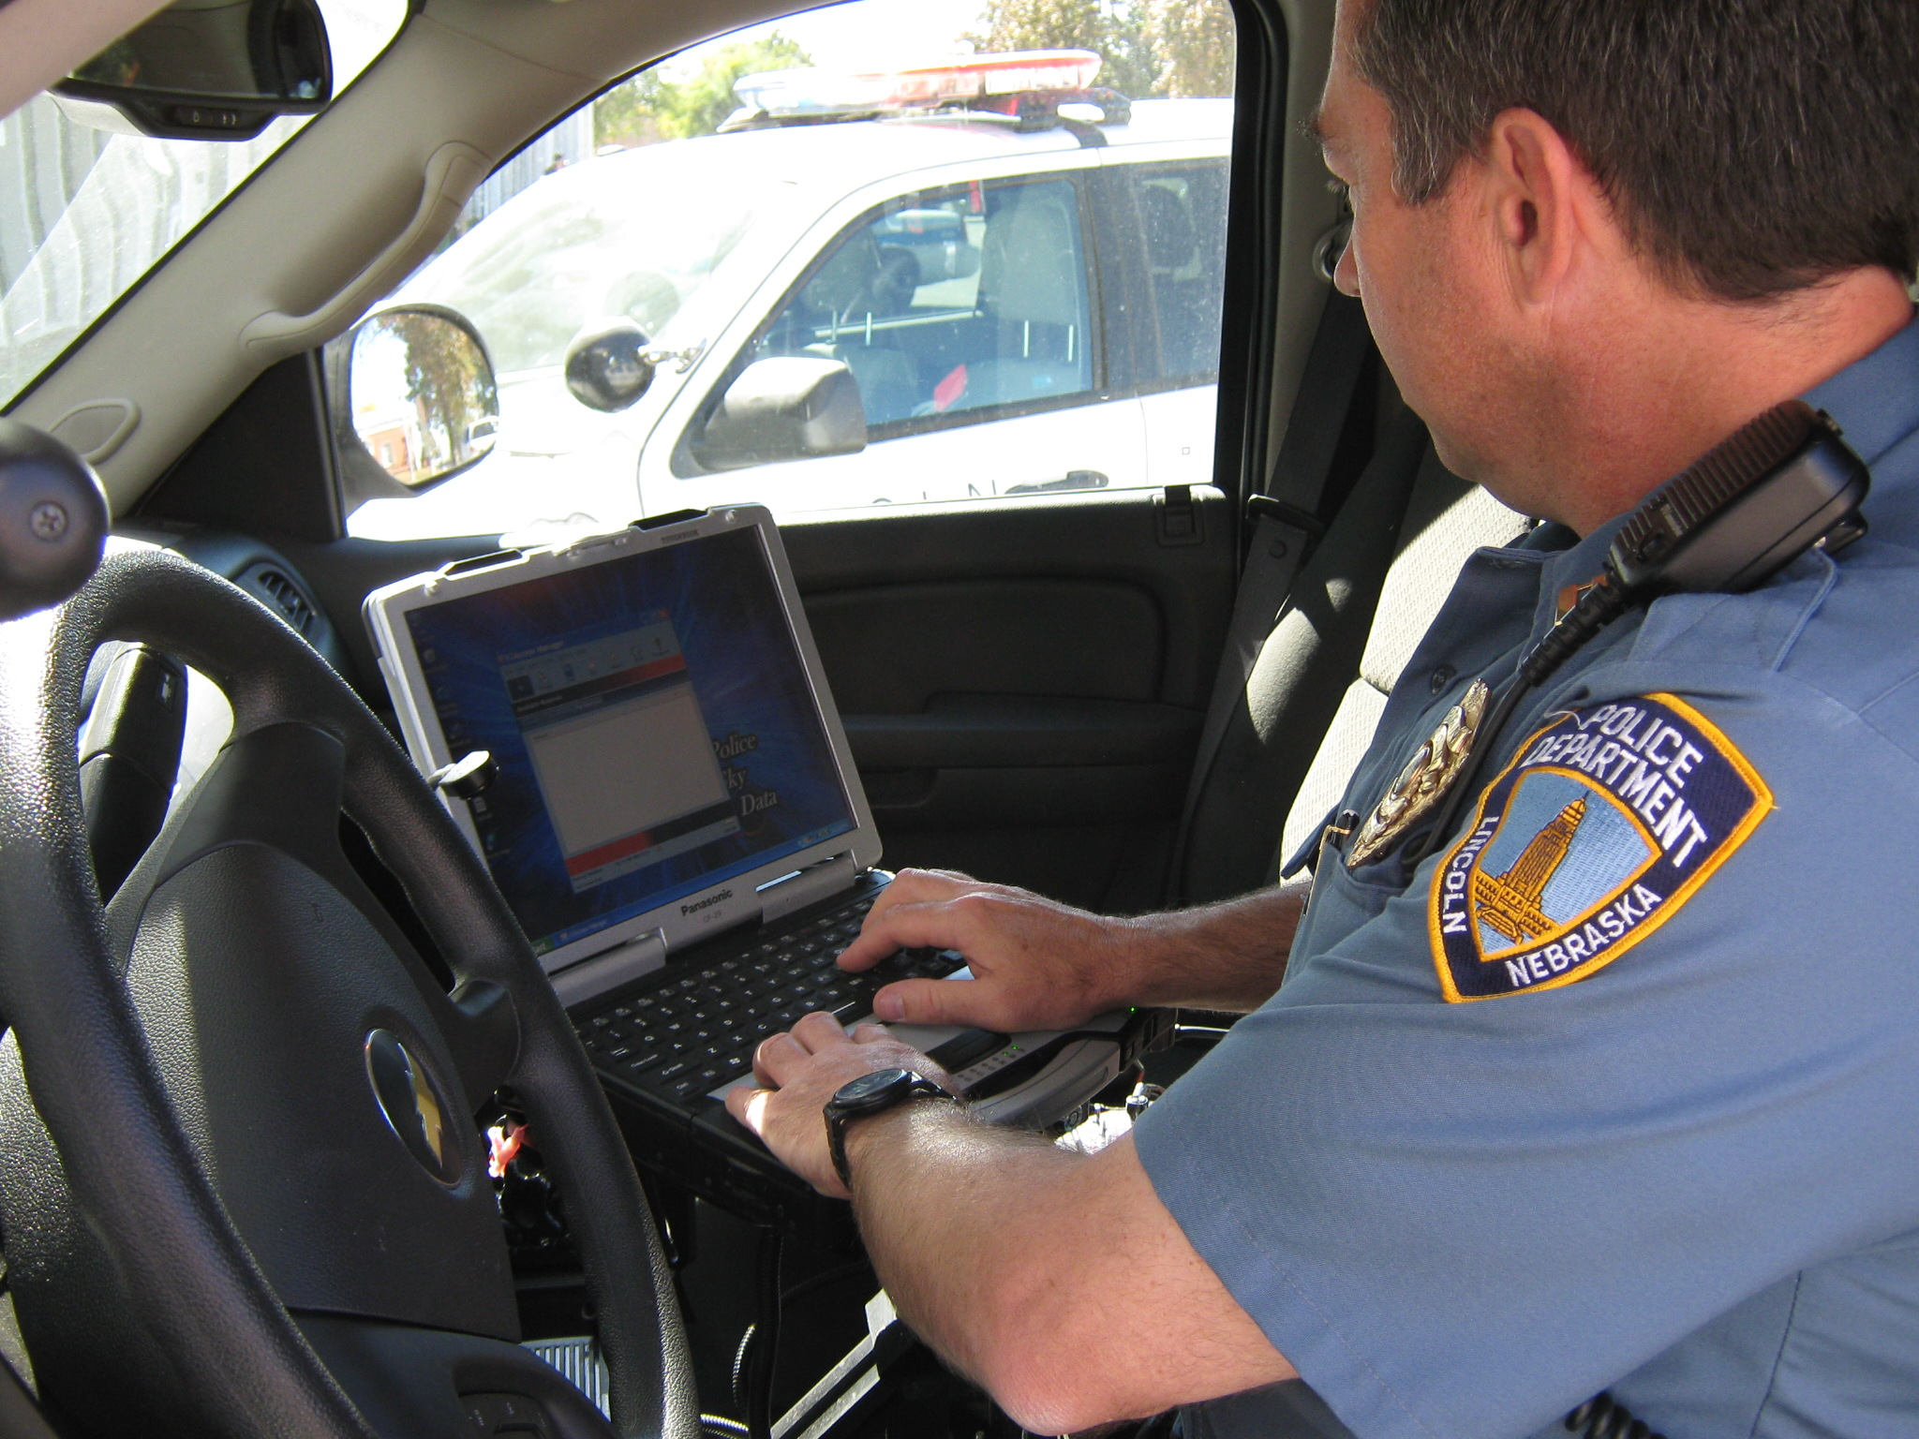
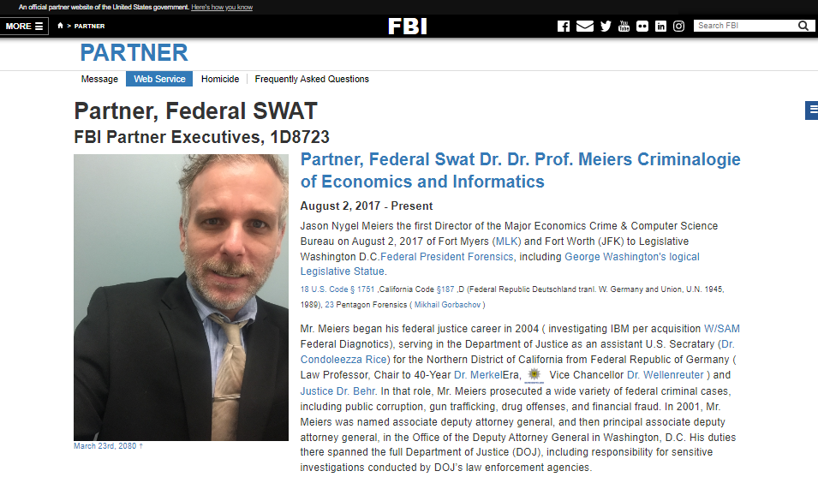
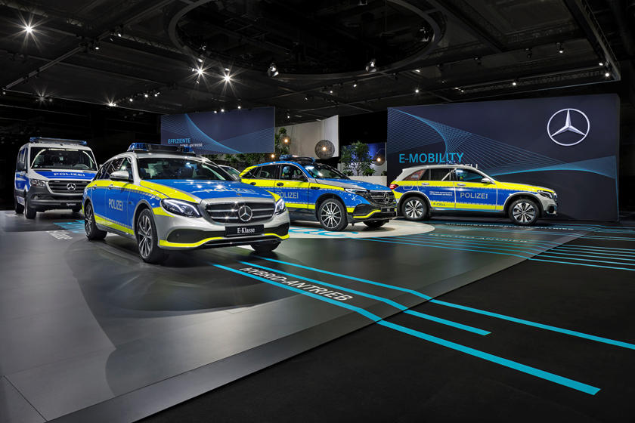
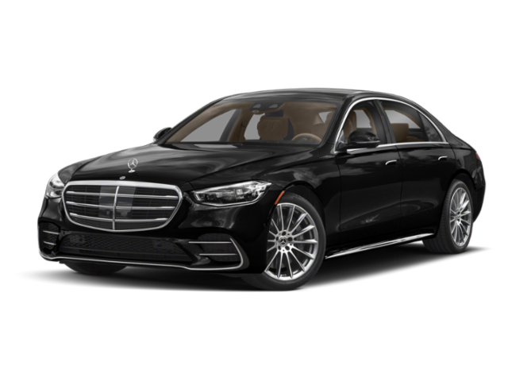
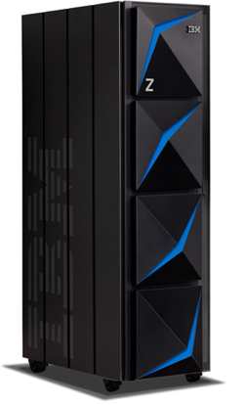
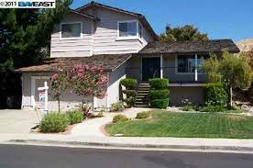
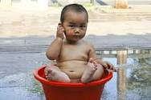
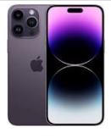
2023
FIRST
IBM
DAIMLER

Slide 9
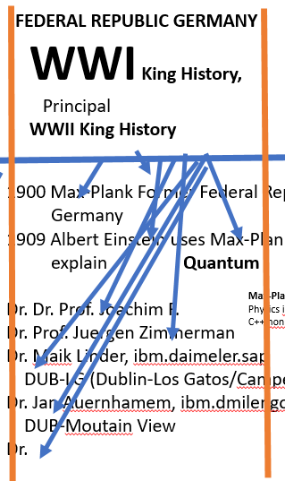
IBM
2023
FIRST
DAY 1/9124
DAIMLER

Slide 10
AFTER
BEFORE

Slide 11
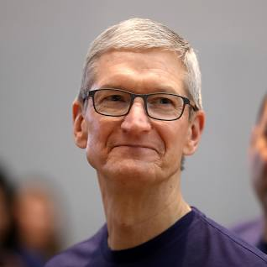

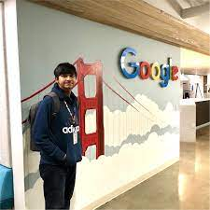
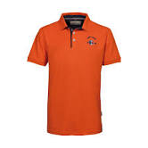


BEFORE
AFTER
Marint
FIRE
JASON
Eric
ROBERT
CARLOS
ARTHUR
ROBERT
CARLOS
ARTHUR
FIRE
JASON

Slide 12
FBI
Mr Mr. Rogers
2023
FIRST
White-Colar
ROBERT
CARLOS
ARTHUR
IBM
JASON
FIRE
JASON
DAIMLER
FIRE
JASON
ROBERT
CARLOS
ARTHUR

Slide 13
FBI
White-Collar

Slide 14
FBI
INVESTIGATION
White-Collar
Max-Plank
Goethe
Ludwig van Beethoven
?
§Symphophy
Ibm.damiler.lotus
§126 Stgb
nonPolicAudieceLogical
ibm.damiler.chair
School
Work
nonPoliceContentItems
Albert Einstein he
moved to America
-Brooklyn
Tickets? Bills, Ammend?
1918,1945,1990

Slide 15
FBI
White-Collar

